Slide 1
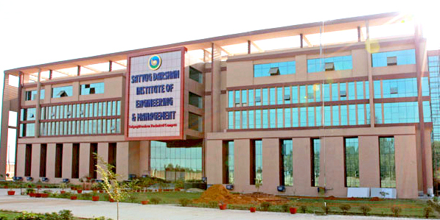
2021 - 2022
BACHELOR OF TECHNOLOGY
IN
COMPUTER SCIENCE & ENGINEERING
Submitted By :
AAYUSH JOSHI
ADITYA SHARMA
ANJALI PAL

Slide 2
Technology Used website development
LANGUAGE USED
HTML
PHP
CSS
JAVASCRIPT
MYSQL

Slide 3


INTRODUCTION OF PROJECT MUSIC WEBSITE – breathless music
This Photo by Unknown Author is licensed under CC BY-NC

Slide 4
SOFTWARE USED
BOOTSTRAp
Vscode
WAMP SERVER

Slide 5


ADDED FEATURES
Contact information
Social media links
A way to listen
A well written biography
Blog
sign up
Photos

Slide 6
Web developer tools
Firefox – F12 opens the Web Console / Browser Console (since Firefox 4). ...
Google Chrome – Chrome Developer Tools (DevTools)
Internet Explorer and Microsoft Edge – F12 opens Web Developer Tools (as of version 8)
Opera – Opera Dragonfly.
Safari – Safari Web Development Tools (as of version 3)

Slide 7

main steps on how to develop a music streaming website:
Set the requirements and create a list of essential features.
Hire a team of experienced developers.
Develop an MVP version of your music streaming service.
Get users' feedback and add advanced features
Upgrade the music streaming website regularly

Slide 8
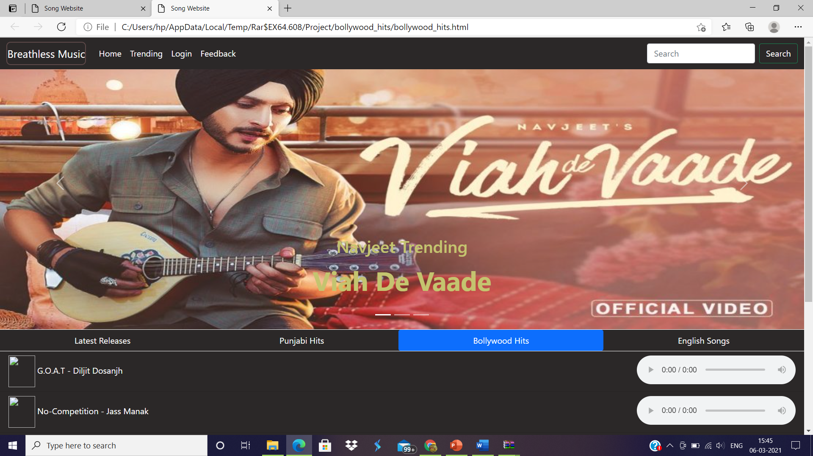
Website look like

Slide 9

Any queries ?
This Photo by Unknown Author is licensed under CC BY-NC

Slide 10



